Slide 1
Programming Logic
Image manipulation and editing with Pillow

Slide 2
Pillow – the Python Imaging Library
https://pillow.readthedocs.io/en/stable/

Slide 3
You'll need some example images
Internet Image sources:
Unsplash: https://unsplash.com/
Wikimedia Commons: https://commons.wikimedia.org/wiki/Main_Page
Pixabay https://pixabay.com/
Pexels: https://www.pexels.com/royalty-free-images/
Flickr's creative commons license images https://www.flickr.com/creativecommons/
And/or your own pictures

Slide 4
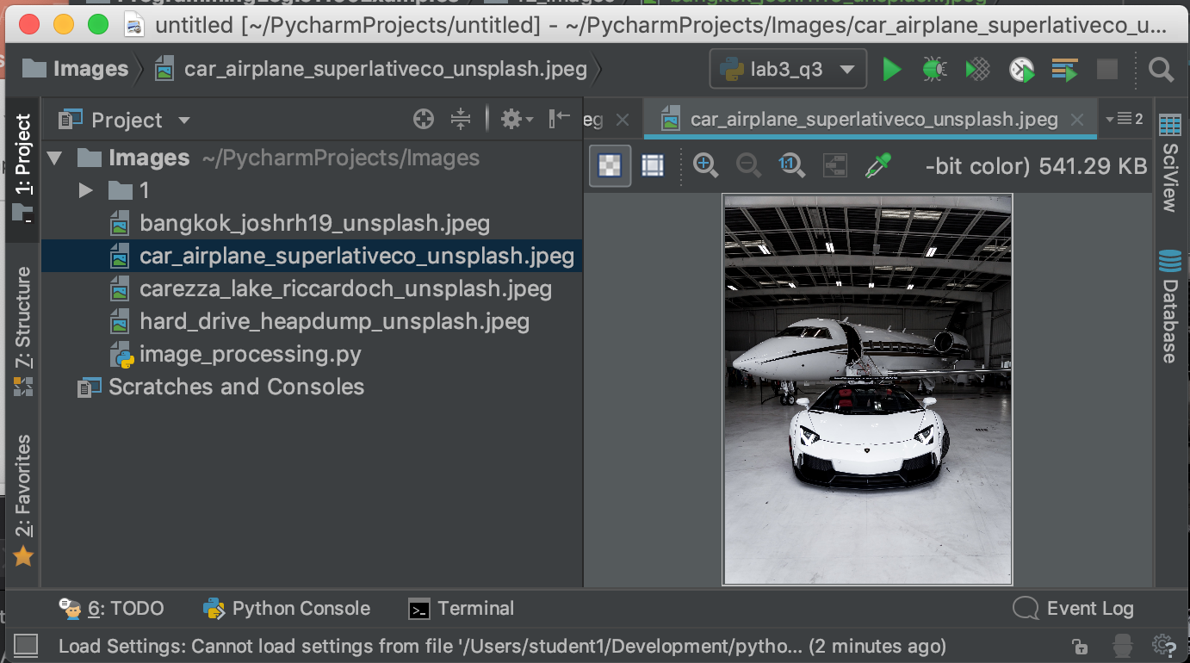
Download 3-4 example images
Note where each image was downloaded from, and who took the picture
Start a new PyCharm project
Copy your images into this project
You can view images in PyCharm's editor

Slide 5
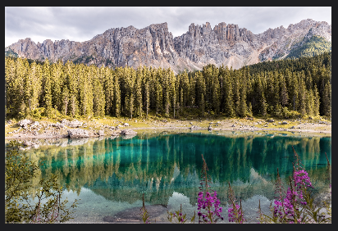
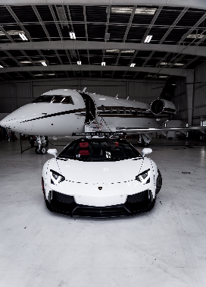
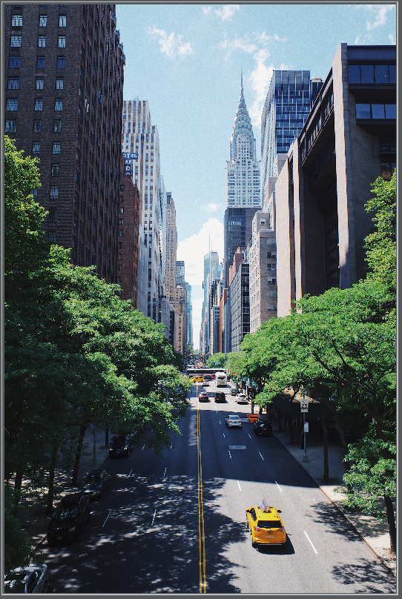
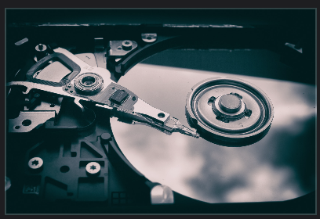
For example…
Car and Airplane: Superlative Co on Unsplash, https://unsplash.com/photos/CvF4KcRJGAg Carezza Lake: Riccardo Chiarini on Unsplash, https://unsplash.com/photos/2VDa8bnLM8c Hard Drive: Patrick Lindenberg on Unsplash, https://unsplash.com/photos/1iVKwElWrPA New York: Photo by Robert Bye on Unsplash https://unsplash.com/photos/WTPp4wgourk

Slide 6
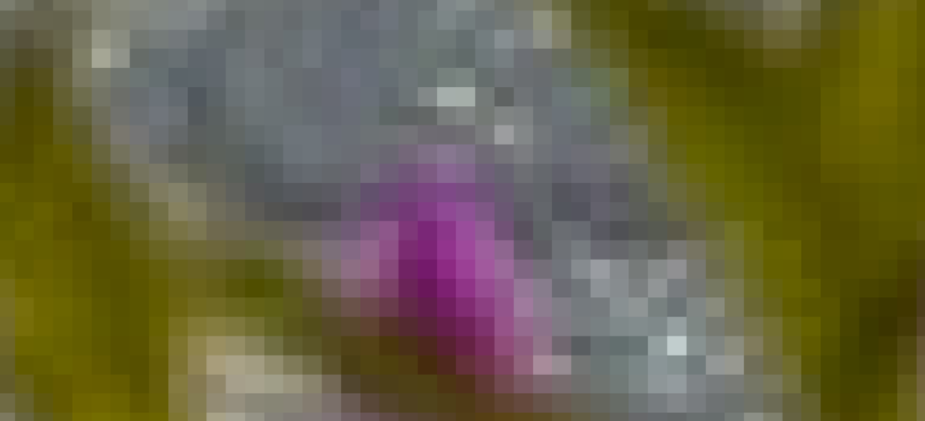
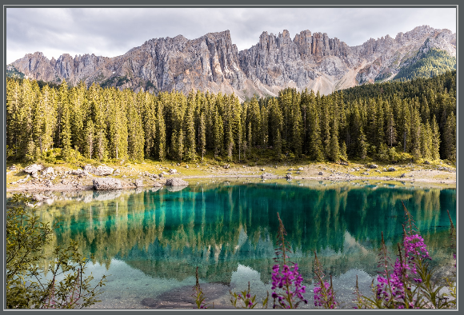
Image basics
Images are made of pixels
Zoom into one of your images in PyCharm to see the pixels
One pixel is a square that's all one color
Pixels are small enough that when you look at the image, it looks like smooth color changes
Zoom in

Slide 7
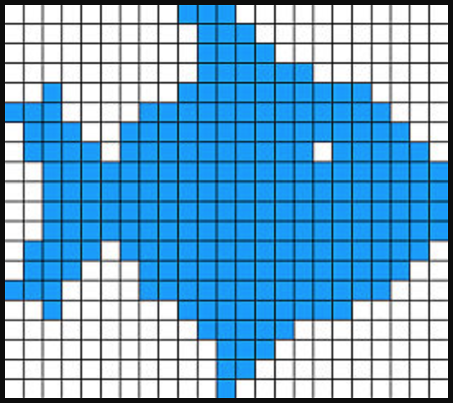
Image basics
An image file contains the color value of each pixel, plus the number of pixels tall, and number of pixels wide
The height of an image is the number of pixels tall
The width of the image is the number of pixels wide
If this fish image is 33 pixels wide
And it is is 20 pixels tall
Then the image size is (33, 20)
Sizes are given as (width, height)

Slide 8
Pillow's features
Resizing images
Rotating or flipping images
Converting between different formats – JPEG, PNG…
Contrast, brightness, color balance, and sharpness enhancement
Applying filters
Cutting and pasting sections of images to make new combined images
Custom processing – can manipulate any pixel individually

Slide 9
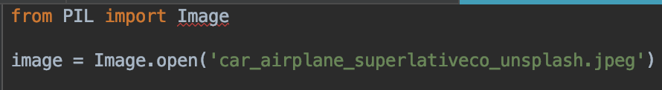
Rotating an image
New Python file
Add this code. Use the filename of your image, not mine
Notice that there's red underlines under Image on the first line

Slide 10
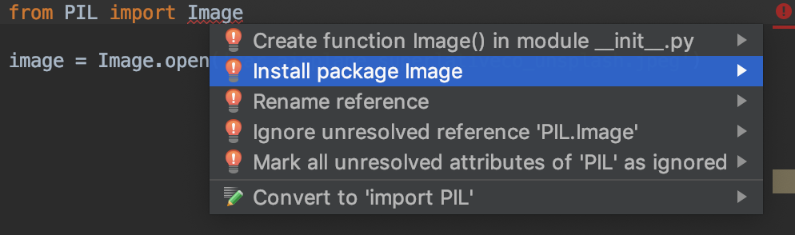
Install package
Move your cursor onto the word Image on the first line
Press Alt + Enter together (PCs)
Press Option + Enter together (Macs)
Select Install package Image
Red underline should go away

Slide 11
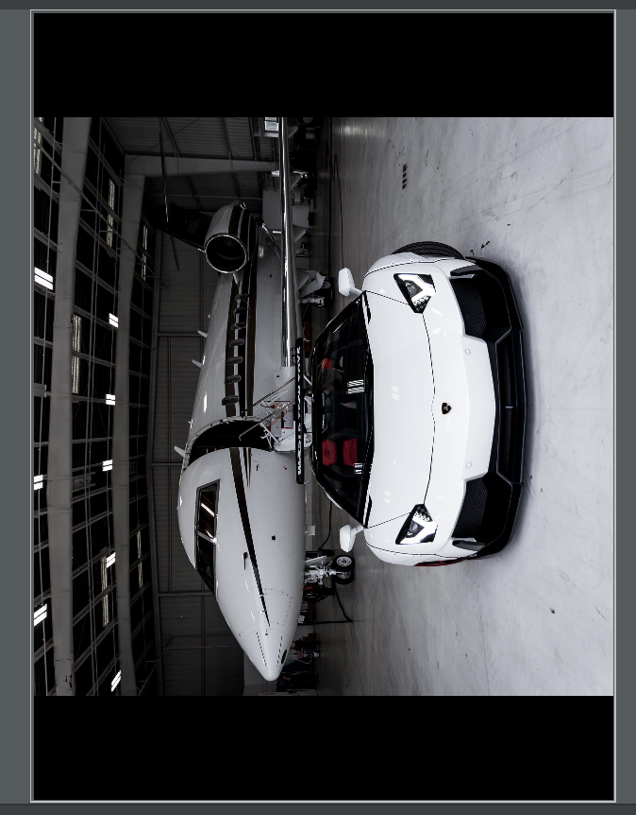
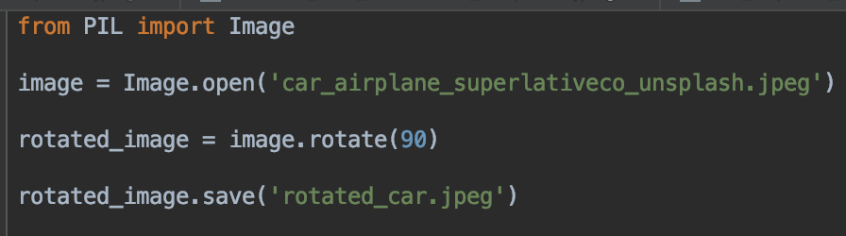
Rotating image – rotate and save
Run and test
image.rotate returns a new image object

Slide 12
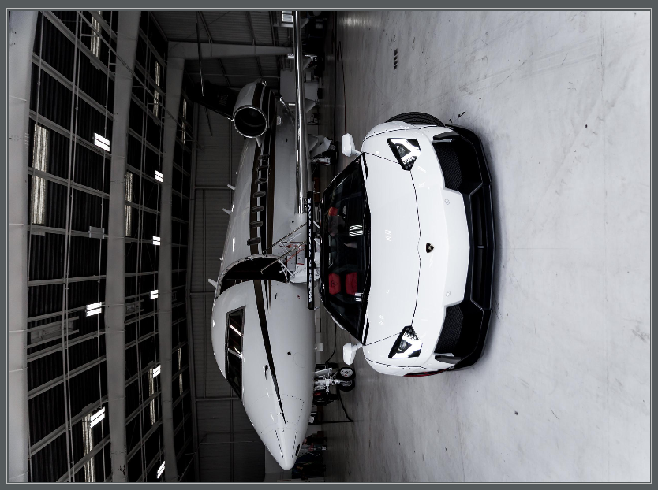
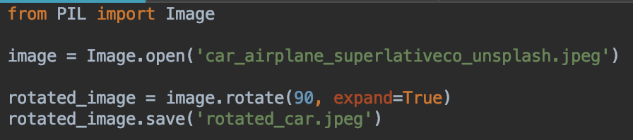
Rotating image – why are there bars at top and bottom?
The default behavior is to make the rotated image the same size as the original
Can modify this behavior with the expand option

Slide 13
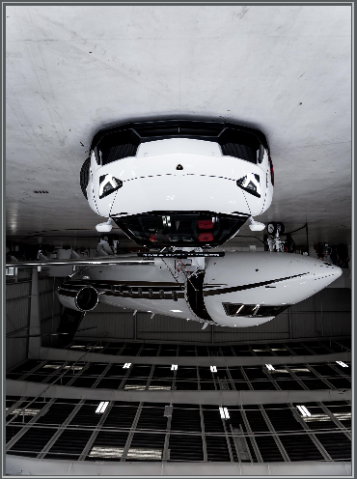
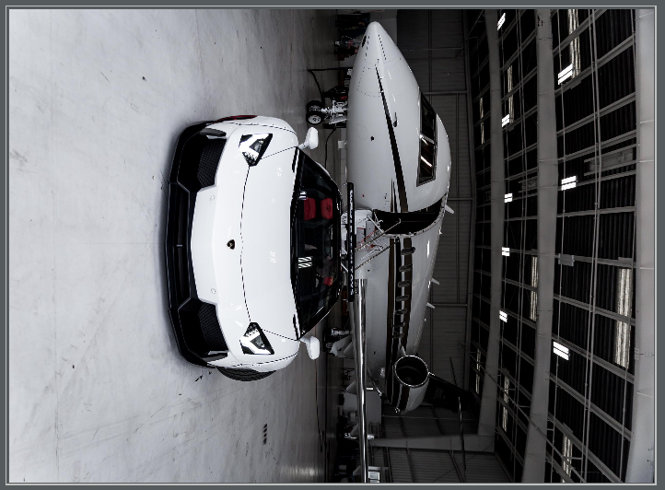
Your turn
Can you rotate your image 180 degrees?
Can you rotate your image 90 degrees in the other direction?
Hint: you can use negative values

Slide 14
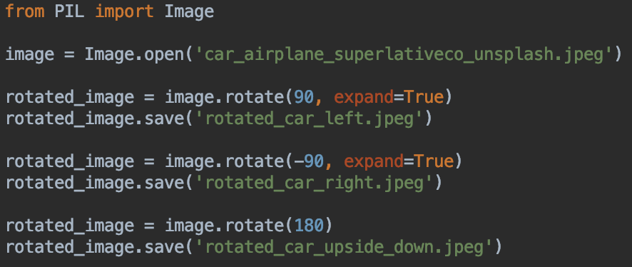
Rotations
Can save different versions of the image to different files
image is the image in memory, in Python

Slide 15
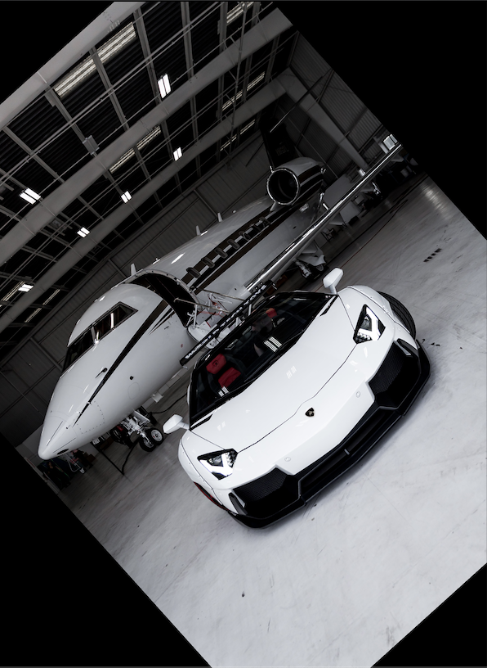
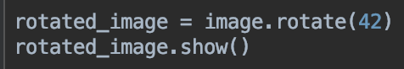
Rotations – other angles
You can rotate by any amount
Experiment rotating images by different numbers
show() opens your computer's image viewer application to see your Image as it is in your program
show() does not save your image
Useful for debugging, seeing how your image looks as you are working with it
Windows – may be Paint; Macs – may be Preview

Slide 16
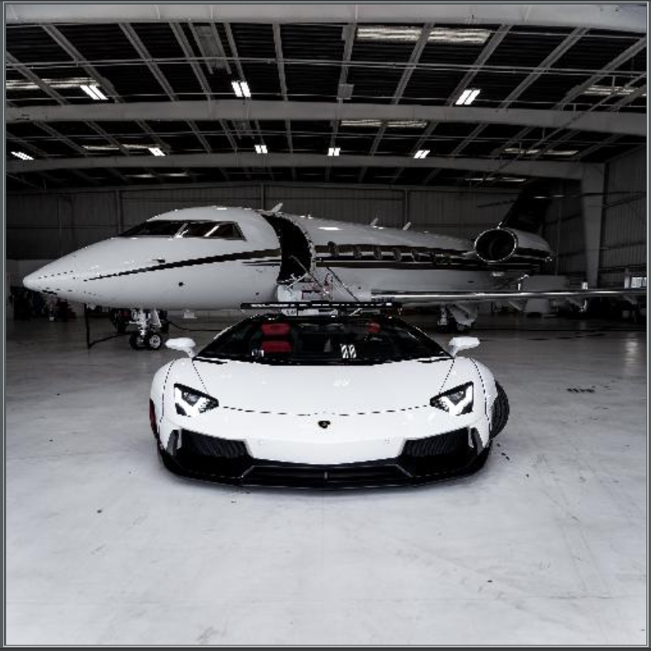
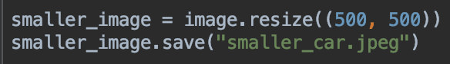
Resizing
Use the resize() method
The method call is easy
You need the extra ( ) in the call
But the output image looks distorted, or squashed

Slide 17
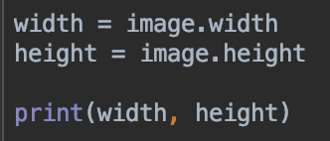
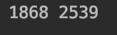
Resizing and preserving aspect ratio
Need to know the original image's height and width
Add this to your program
What is the width and height of your image?
Yours will probably be different

Slide 18
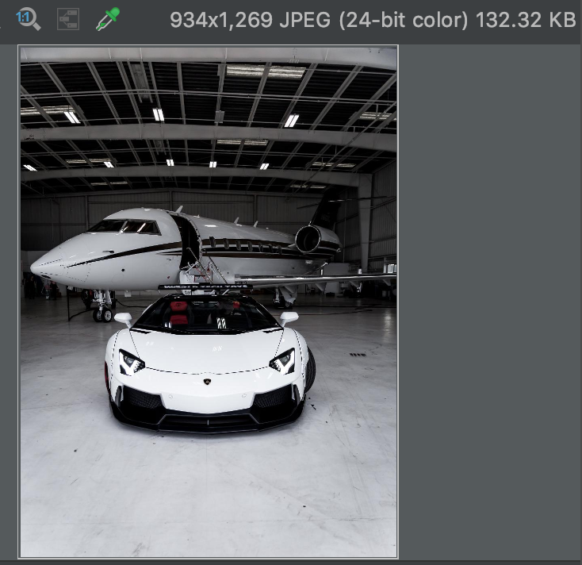
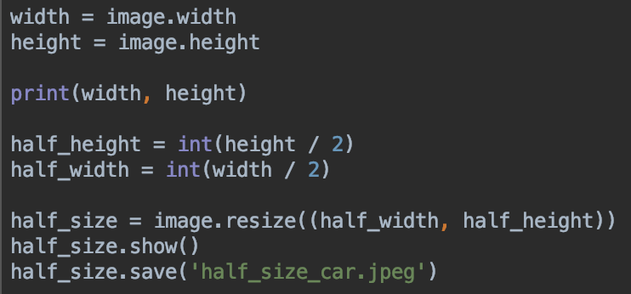
Make the image half the size
resize function makes a new Image object
Make sure the width and height are int values

Slide 19
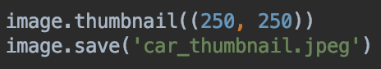
Thumbnails
Modifies the image object (but not the original file)
This resizes to a max dimension of 250, 250
Preserves aspect ratio
You need the extra parenthesis

Slide 20
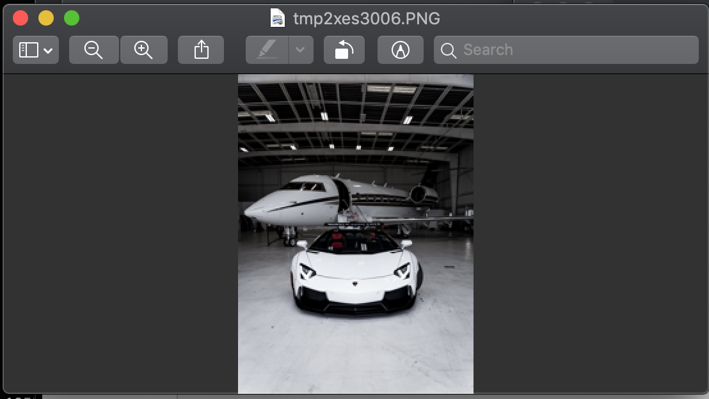
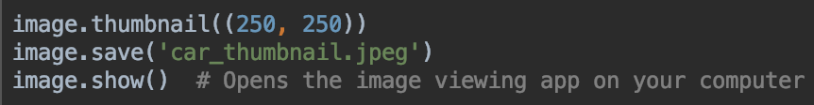
show()
Can call show() for any image to open your computer's image viewer application
Useful for debugging, seeing how your image looks as you are working with it
Windows – may be Paint
Macs – may be Preview

Slide 21
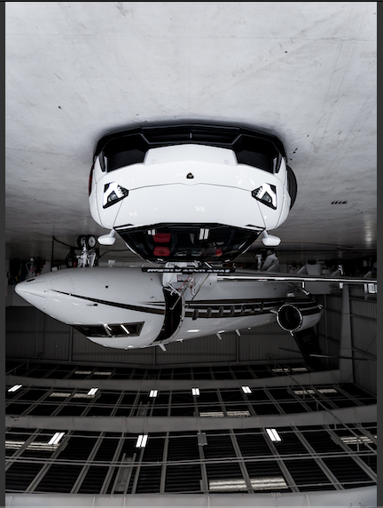
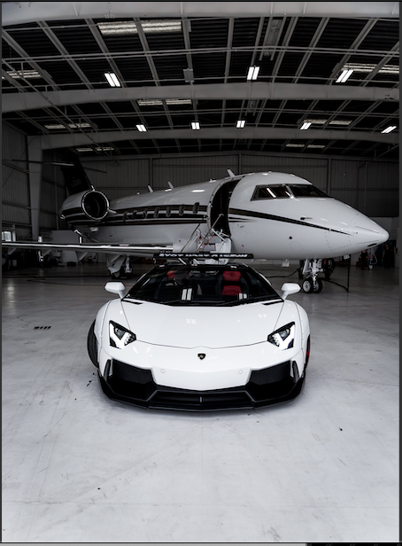
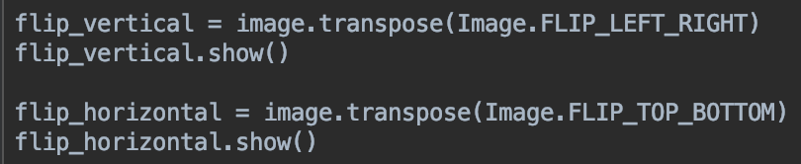
Flipping with transpose function
Your turn: Can you save an upside down version of your image?
What's the difference between transposing with FLIP_TOP_BOTTOM and rotating 180 degrees?

Slide 22
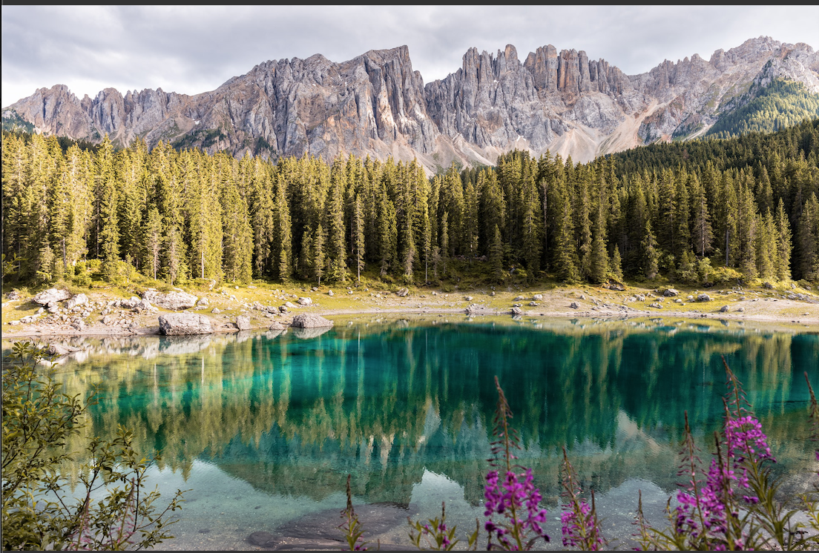
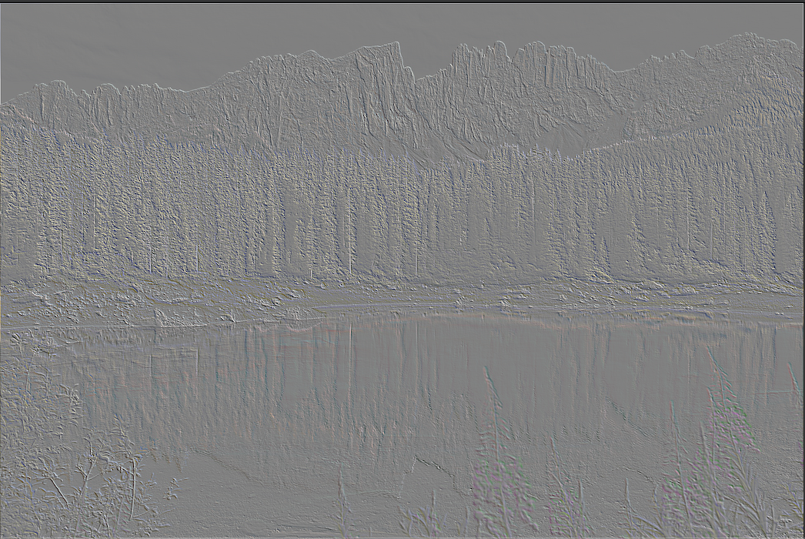
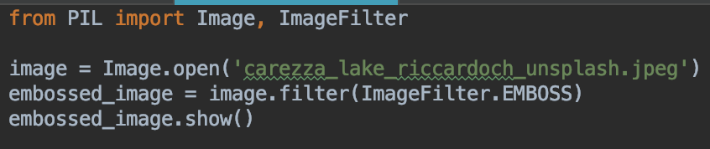
Filtering
Import ImageFilter
call filter method
Creates a new image with the filter applied

Slide 23
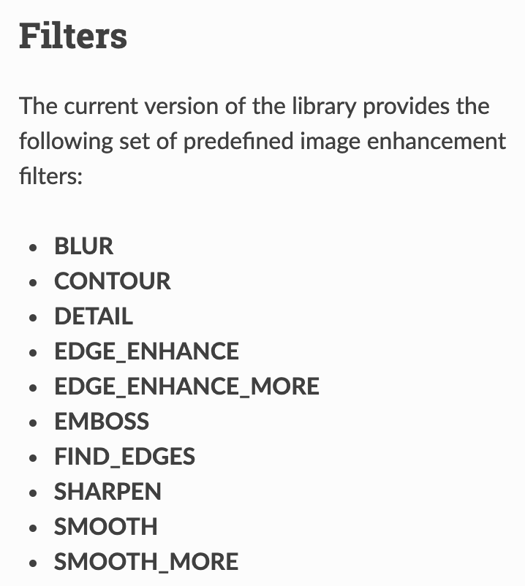
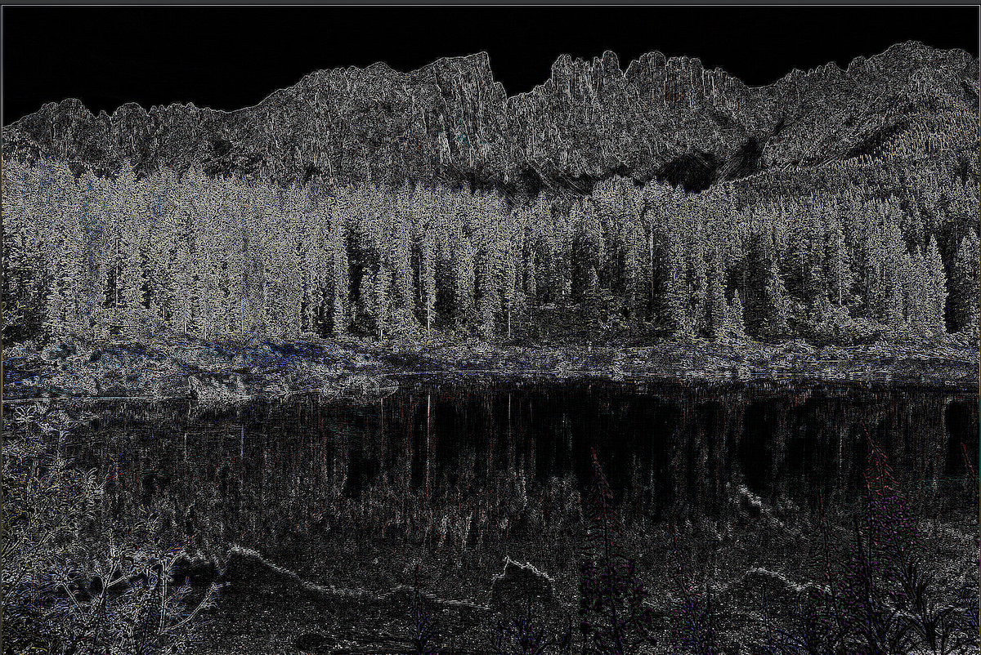
Filtering
Your turn: experiment with other filters
Example: the FIND_EDGES filter

Slide 24
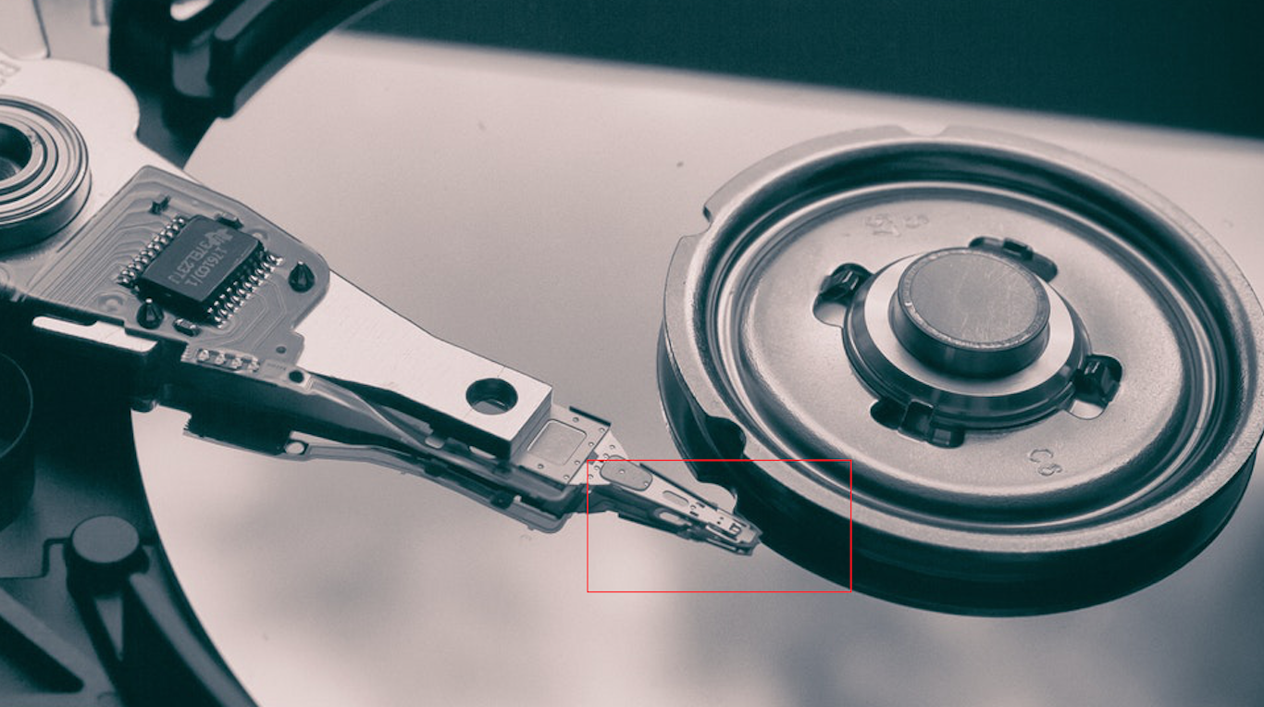
Drawing on an image
For example, you want to highlight a region of an image
Example: draw a box around the hard drive read-write head in this image

Slide 25
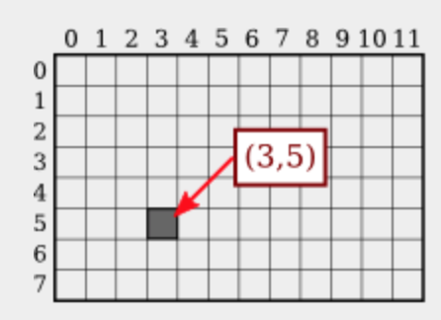
Image coordinates
Coordinates start from the top left corner
http://math.hws.edu/graphicsbook/c2/s1.html

Slide 26
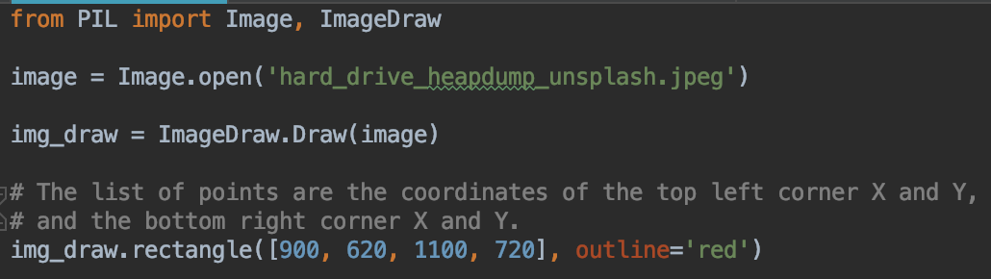
Draw a box
You'll need to adjust the coordinates for your image to draw a box around an interesting area in your own image

Slide 27
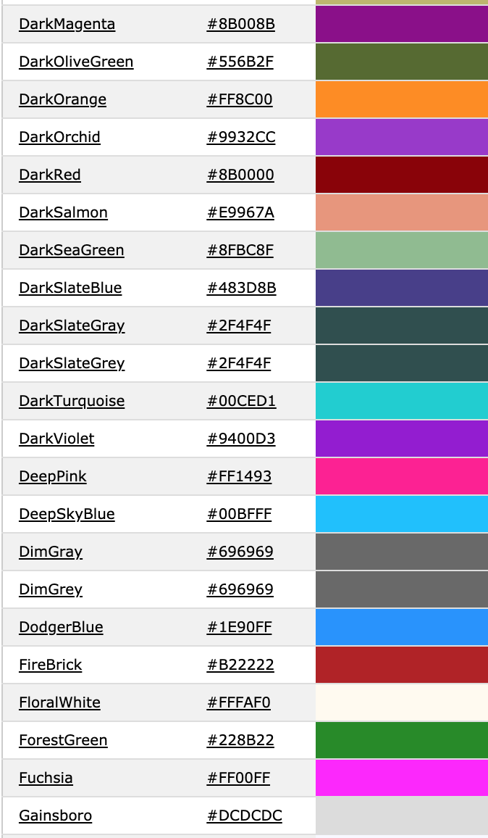
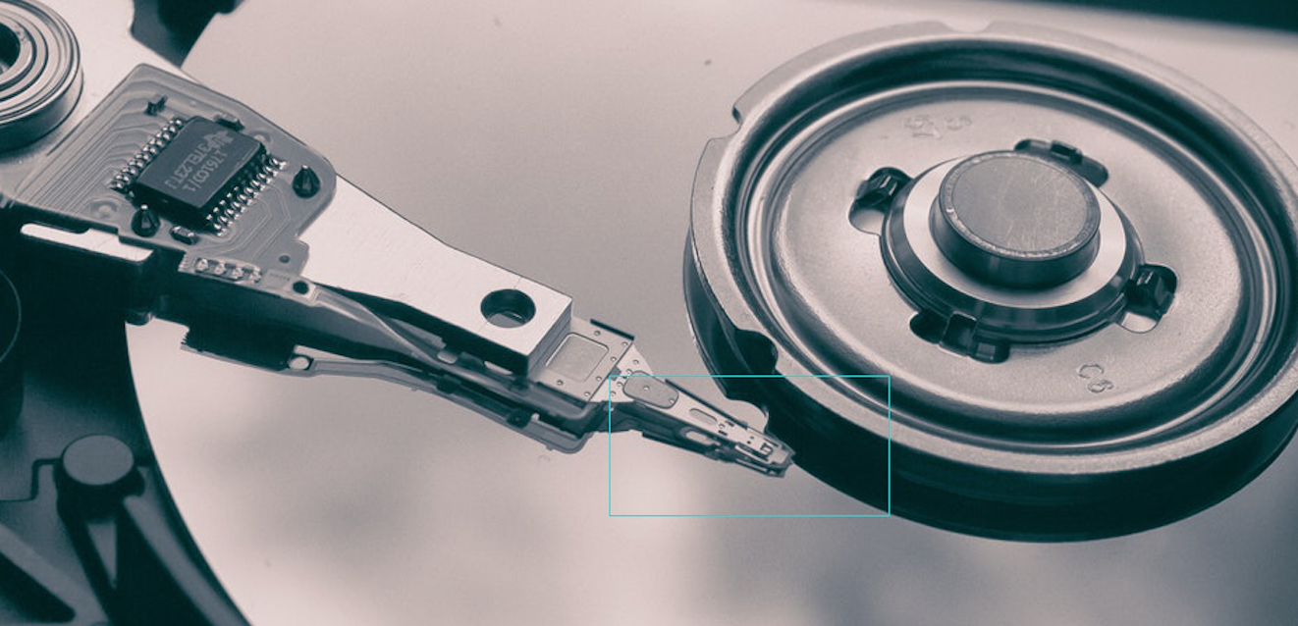
Your turn: change color
You can use any of these color names
https://www.w3schools.com/colors/colors_names.asp

Slide 28
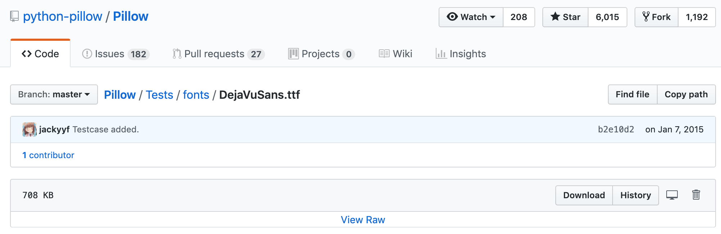
Drawing text
Need a font file: download this file and add to your project
https://github.com/python-pillow/Pillow/blob/main/Tests/fonts/DejaVuSans/DejaVuSans.ttf

Slide 29
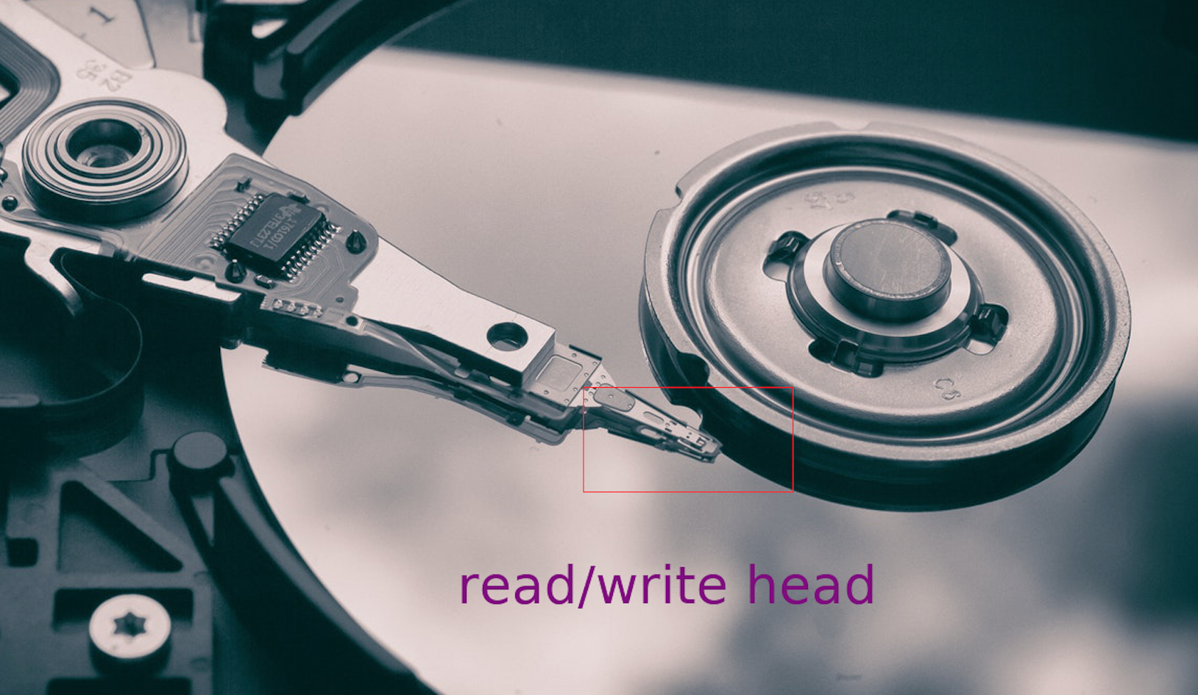
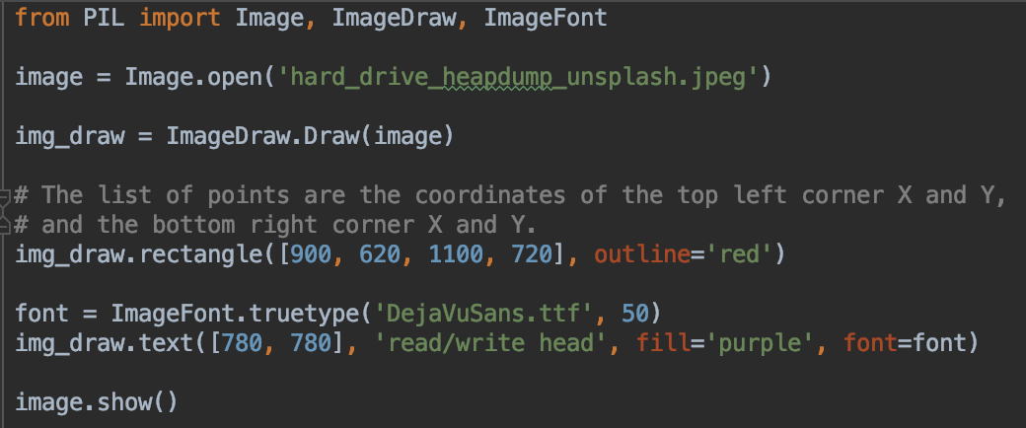
Adding text to an image
Import ImageFont on the first line

Slide 30
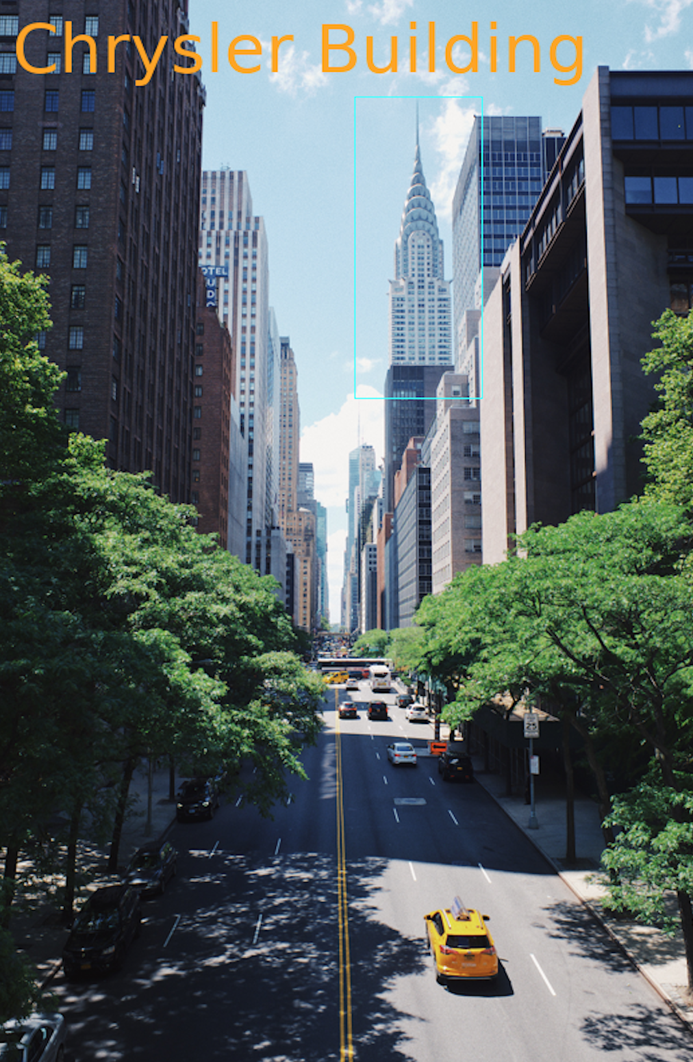
Lab
Choose an image from Unsplash.com
The image is very large, so resize it to ~800 pixels tall
Choose a feature/area you want to highlight
Draw a rectangle around that area
Add a text label near the rectangle with text that describes the feature
Use colors of your choice
Save the image to a new file
https://unsplash.com/photos/WTPp4wgourk

